Slide 1
HOTEL BOOKING MANAGEMENT SYSTEM
Team Members:
Sashank
Avinash
Siddharth
Nikhil
Mentor :
Notes:
Add instructor notes here.

Slide 2
OBJECTIVES
Project Understanding
Approach used
Project Execution
Modules
Learning
Best Practices
Opportunity for improvement
Notes:
Add instructor notes here.

Slide 3
PROJECT UNDERSTANDING
The main objective of this project is to design and develop an online Hotel Bookings Management System
Hotel Bookings Management System can be used to search for hotel rooms and reserve them.
The Hotel Bookings Management System includes functionality of a customer and an admin, and also features like to generate reports.

Slide 4
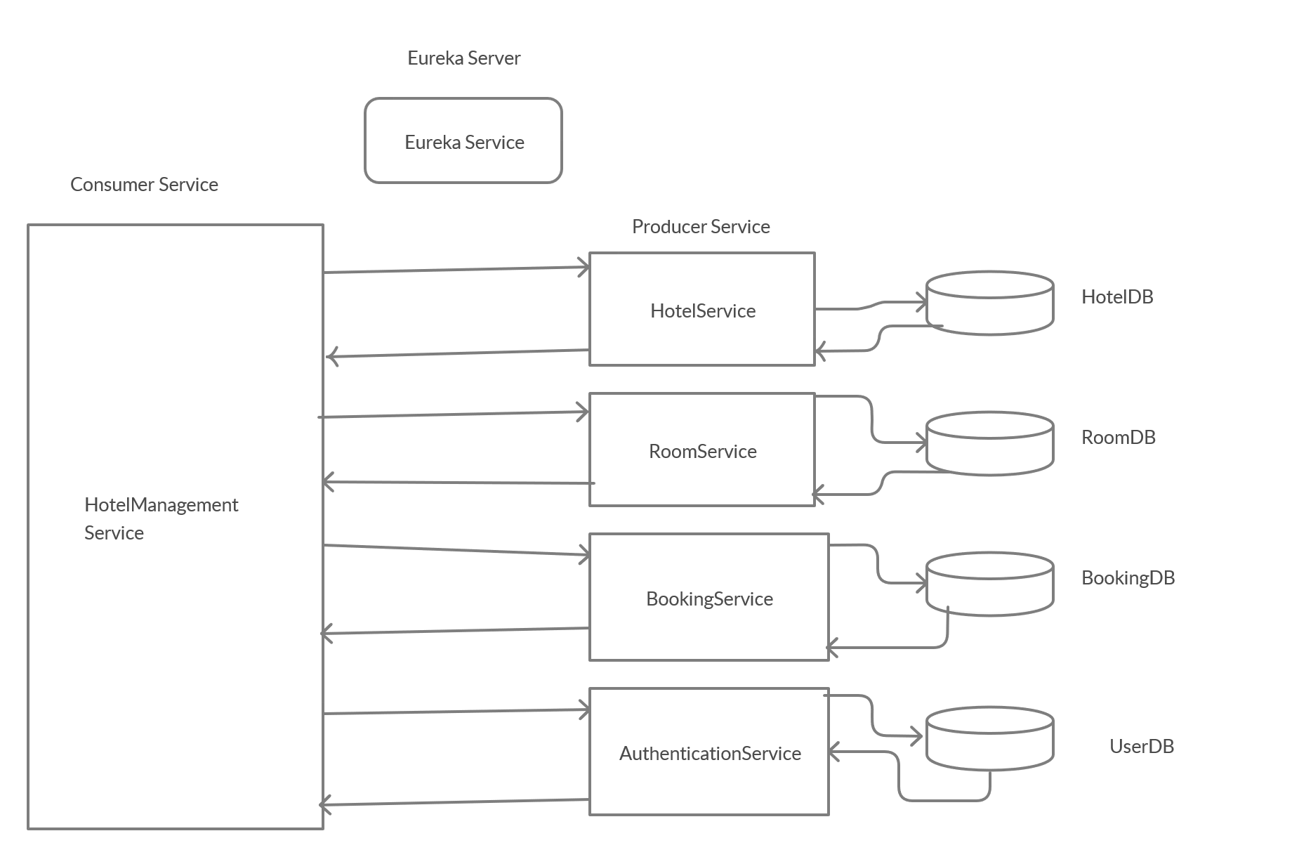
High Level Design Diagram

Slide 5
High Level Design Diagram
Controller
Microservice
User Interface
Controller
Service
Dao
Database

Slide 6
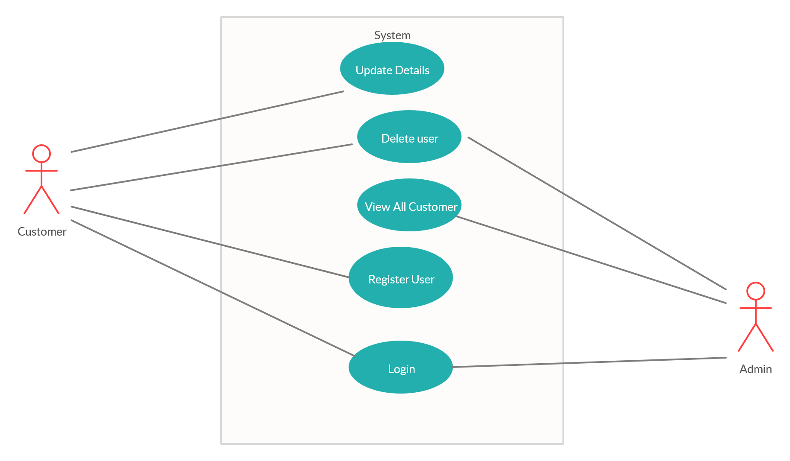
USE CASE DIAGRAM
Authentication Service

Slide 7
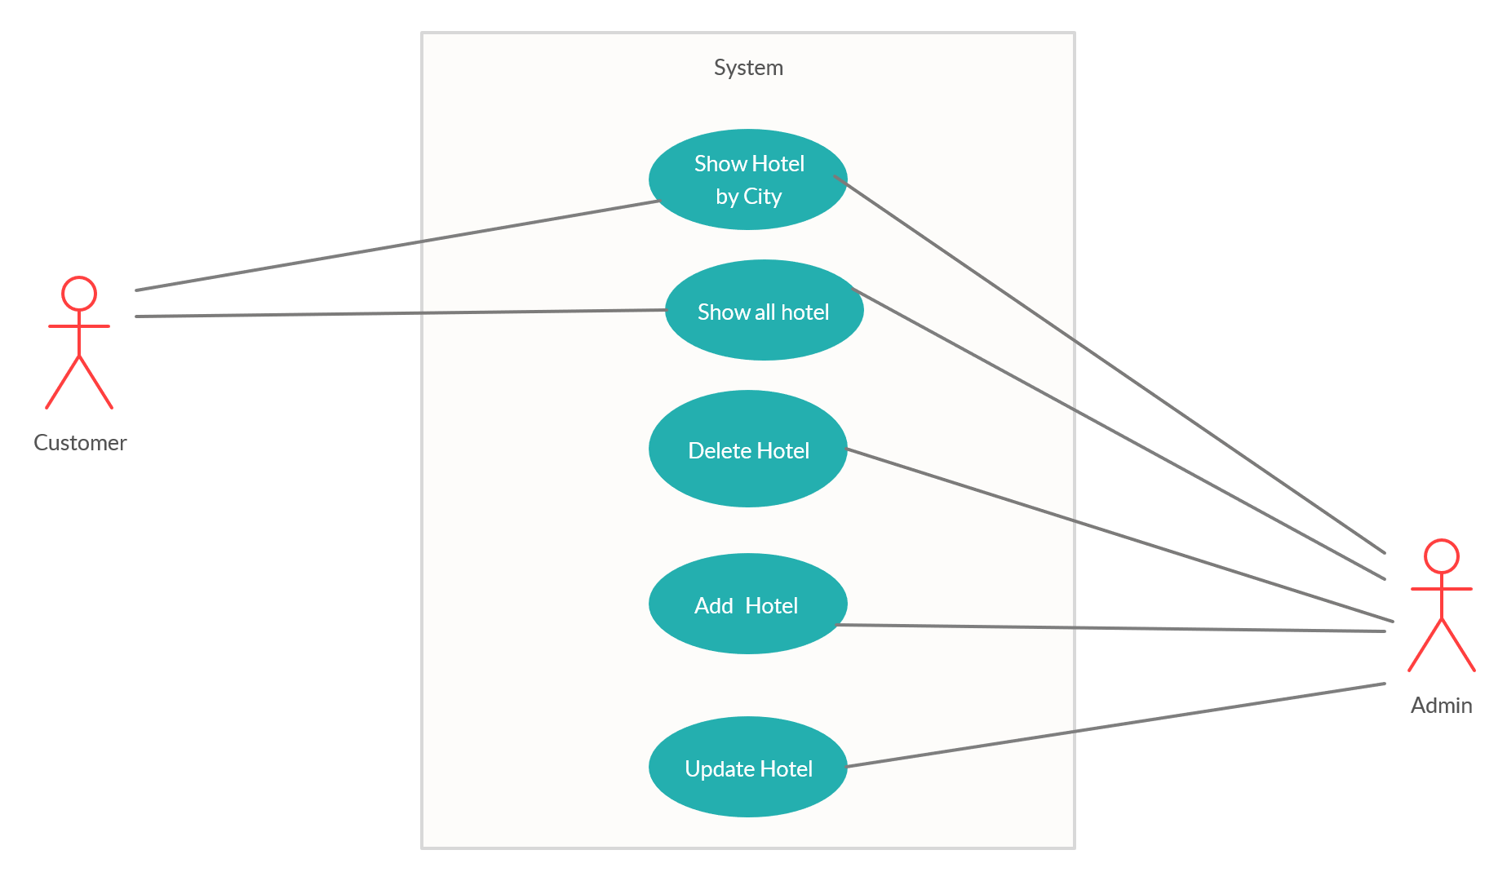
USE CASE DIAGRAM
Hotel Service

Slide 8
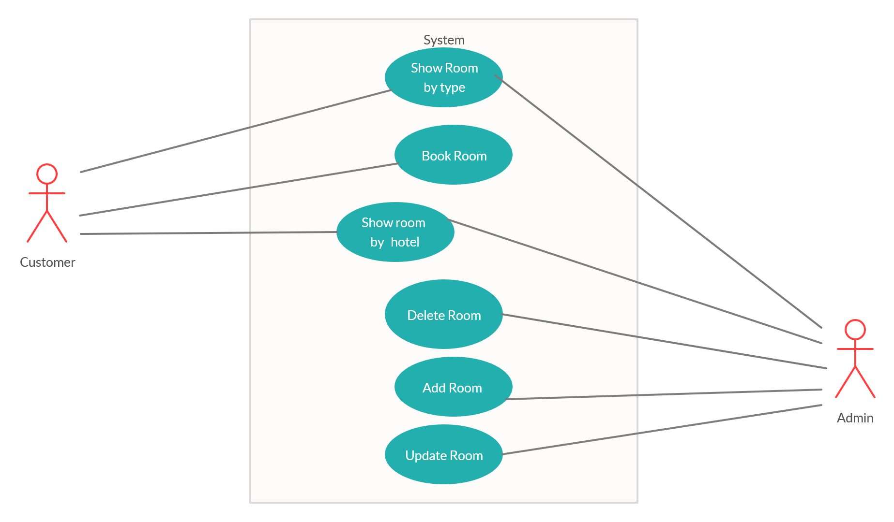
USE CASE DIAGRAM
Room Service

Slide 9
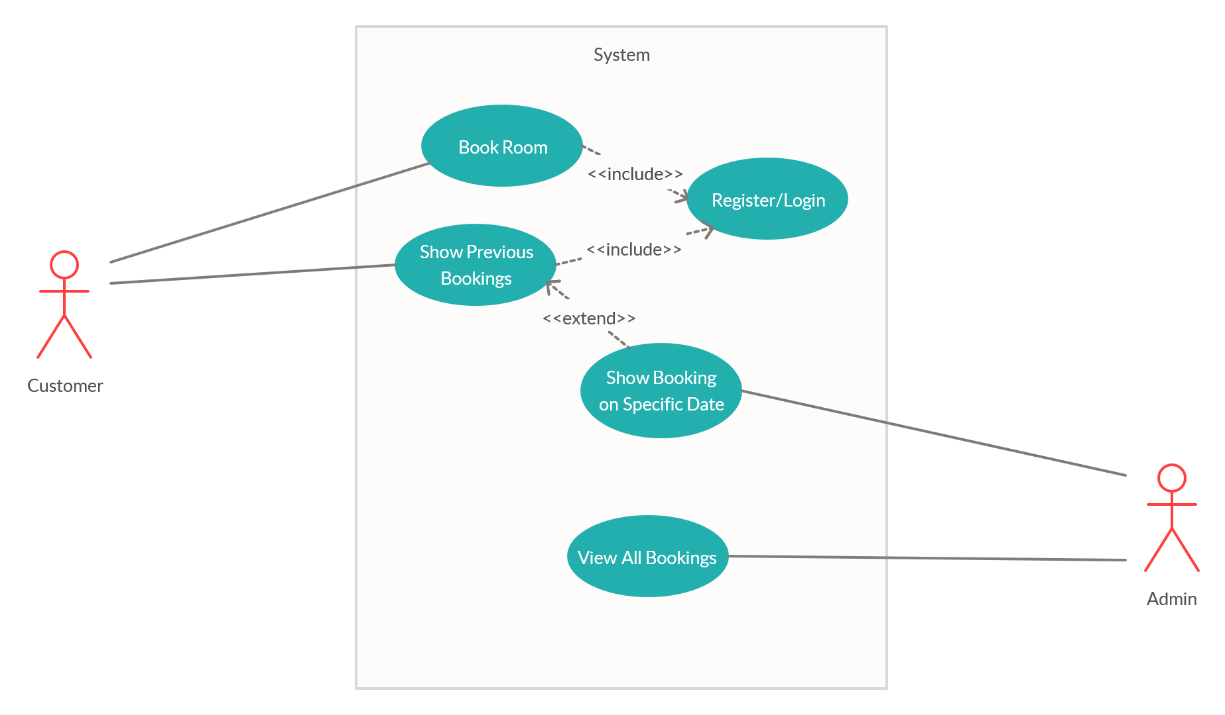
USE CASE DIAGRAM
Booking Service

Slide 10
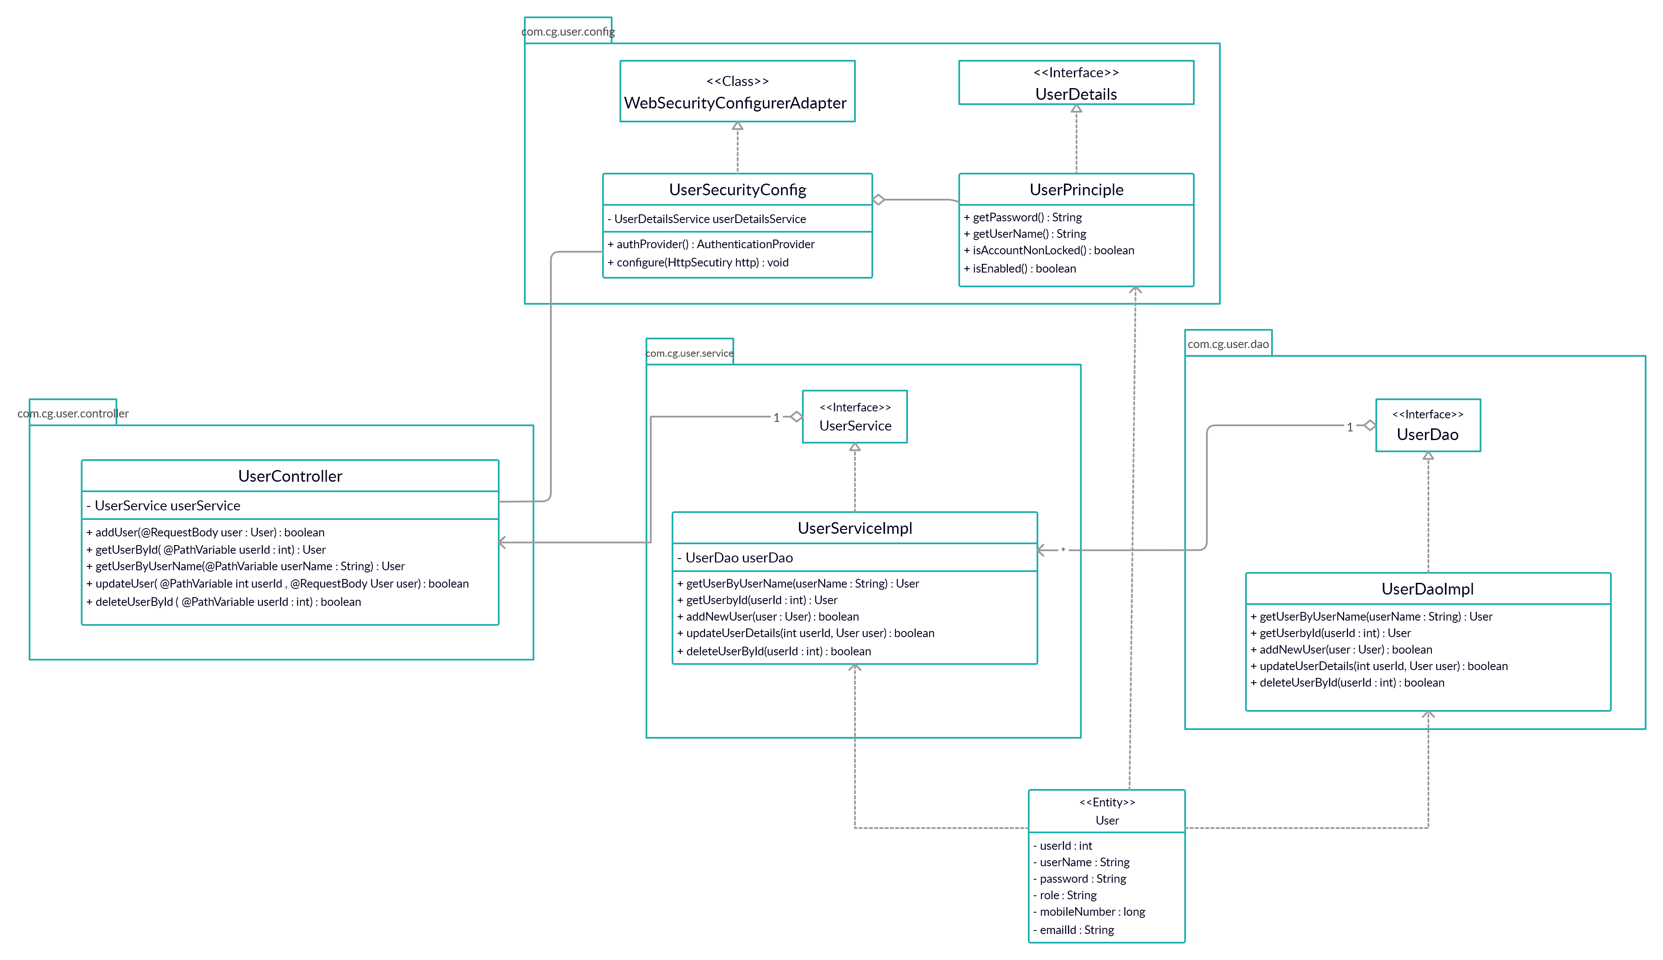
CLASS DIAGRAM
Authentication Service

Slide 11
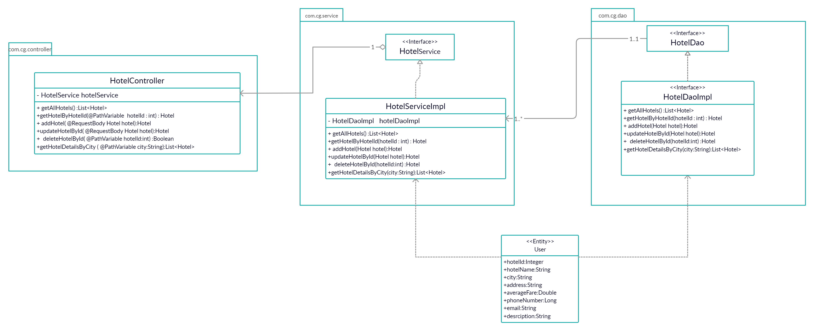
CLASS DIAGRAM
Hotel Service

Slide 12
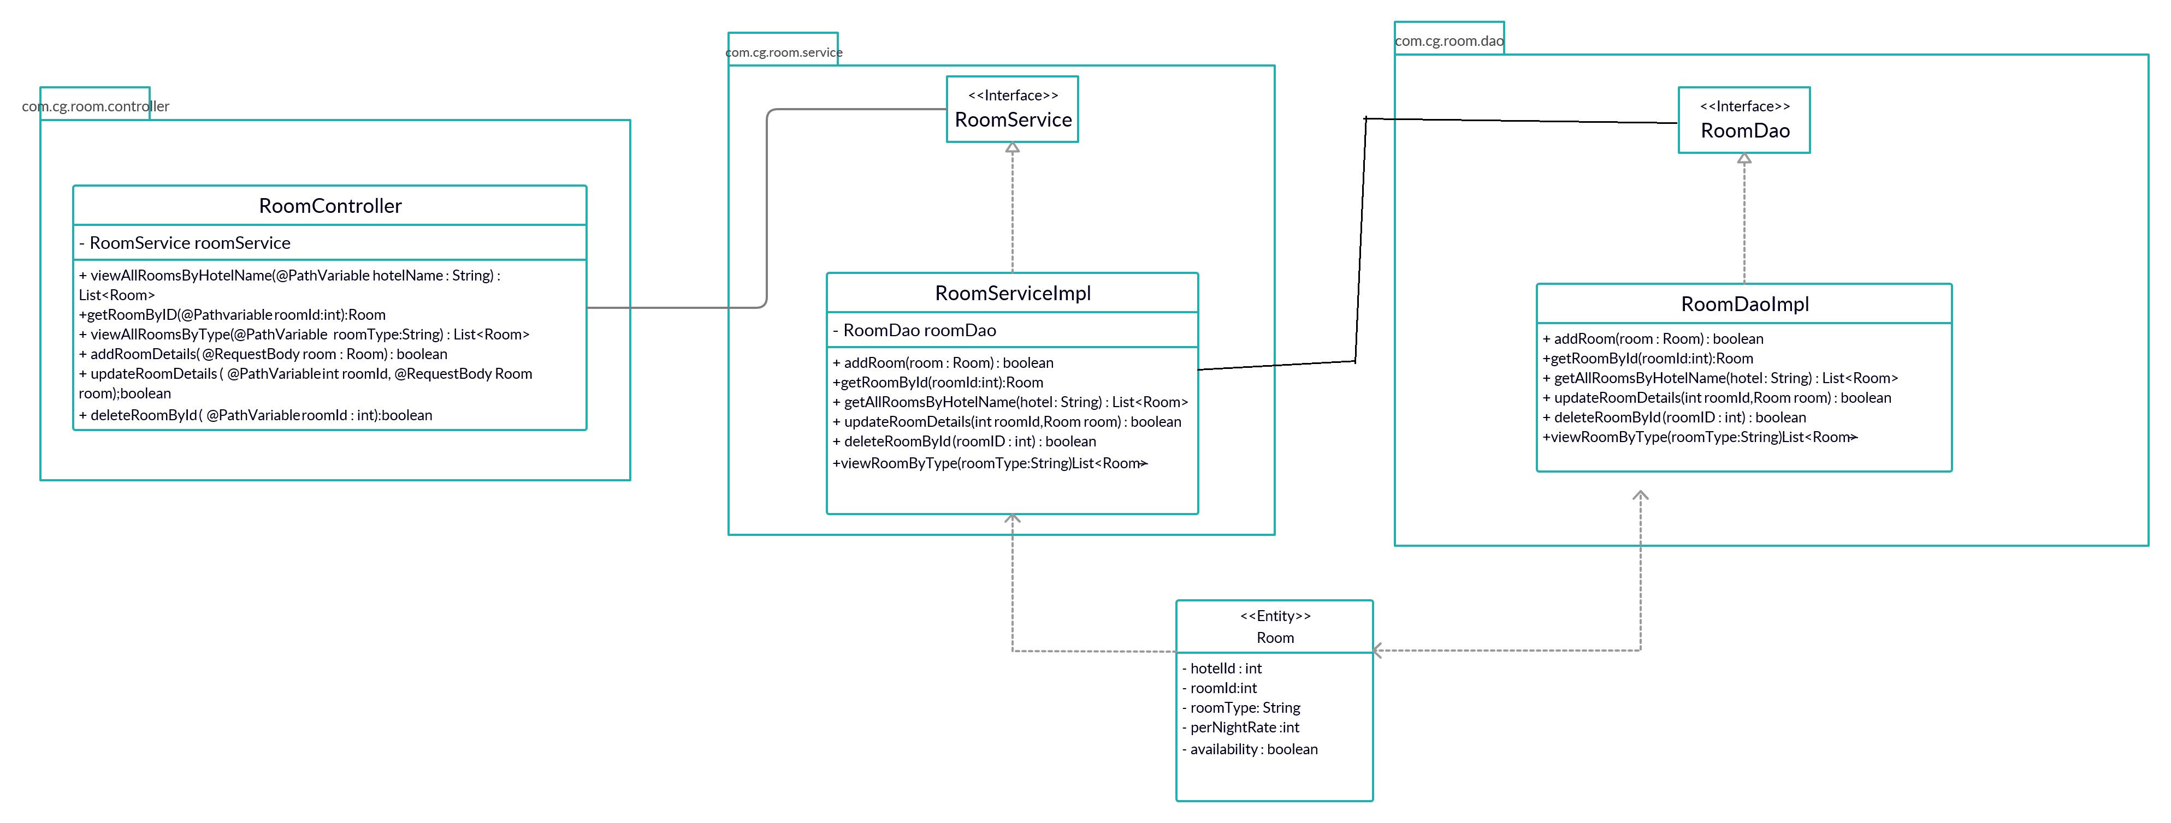
CLASS DIAGRAM
Room Service

Slide 13
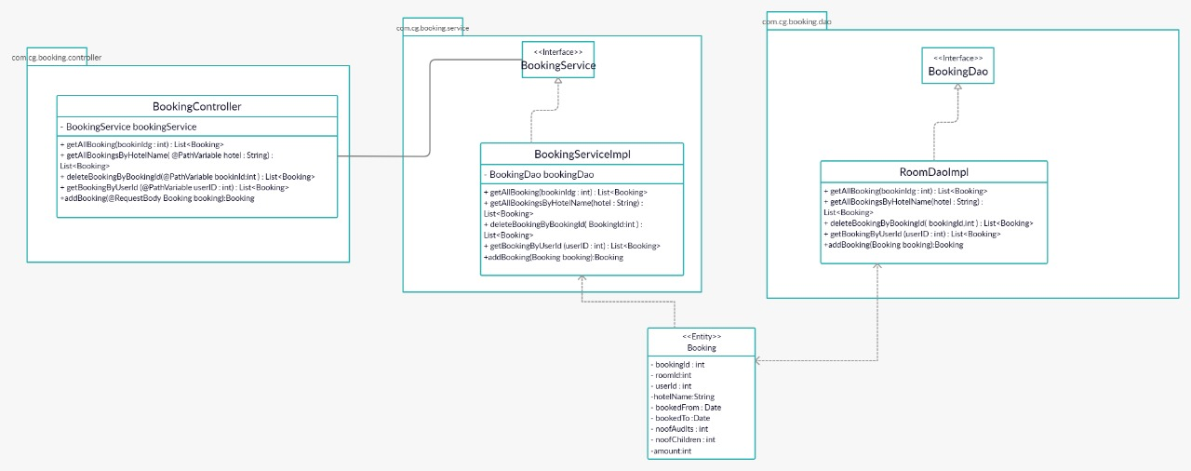
CLASS DIAGRAM
Booking Service

Slide 14
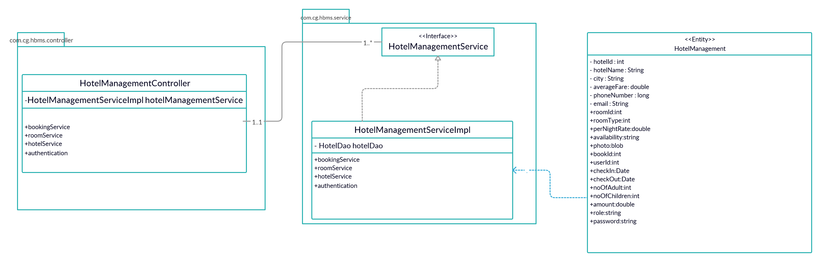
CLASS DIAGRAM
HotelManagement Service

Slide 15
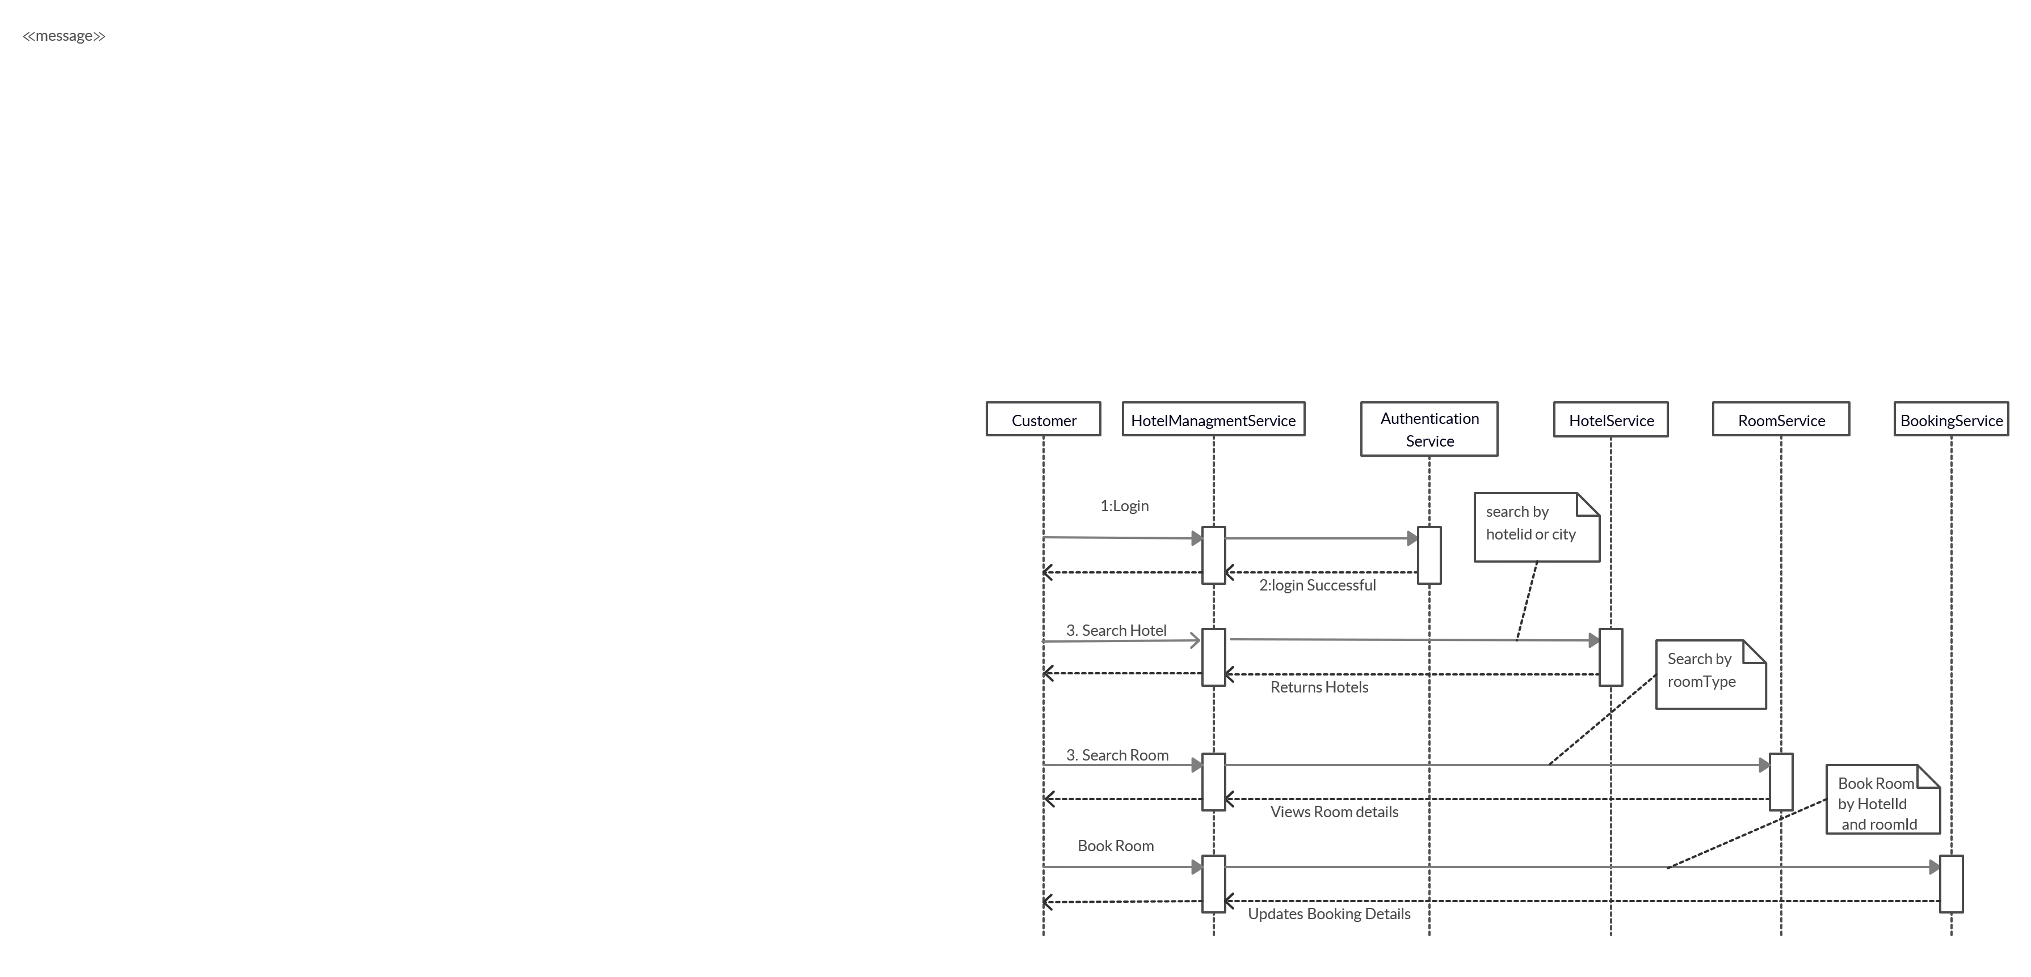
SEQUENCE DIAGRAM FOR CUSTOMER

Slide 16
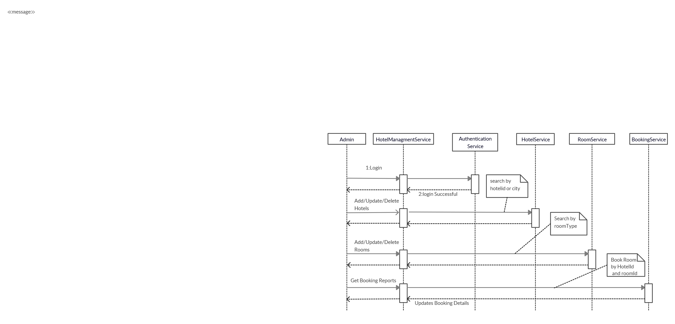
SEQUENCE DIAGRAM FOR ADMIN

Slide 17
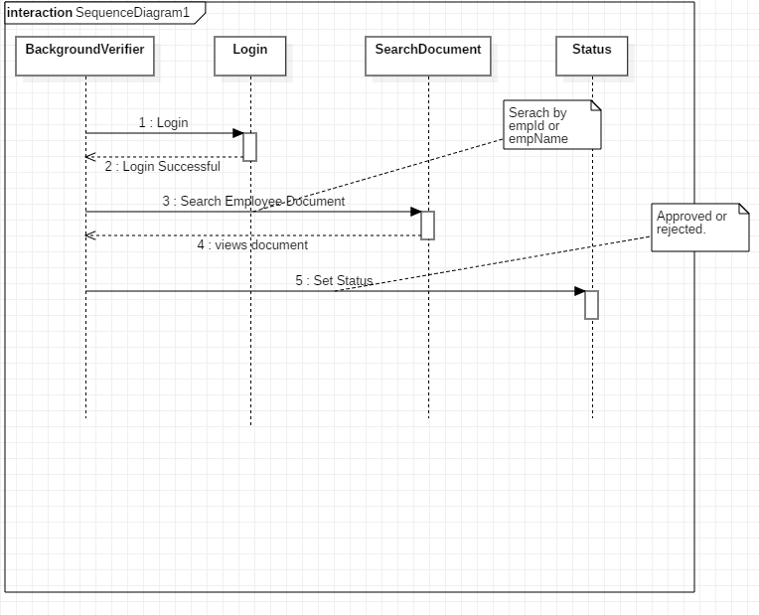
SEQUENCE DIAGRAM FOR ADMIN

Slide 18
APPROACH USED
    Front End & Web Components:–
      Angular 6
    Business Logic Components and Services :-
      - Spring Boot
      - Microservices
    Databases:-
      - H2 DATABASE
      - MySQL(cloud)

Slide 19
PROJECT EXECUTION
Login Module
Customer Module
Admin Module

Slide 20
LOGIN MODULE
Login:
Customer can login into the portal through his/her login credentials.
Admin can login into the portal using admin credentials

Slide 21
CUSTOMER MODULE
Customer:
Login
View all hotels or by city
Book a room
View previous bookings

Slide 22
ADMIN MODULE
Admin Module:
Login
Add/Modify/Delete hotel details
Add/Modify/Delete room details
Generate various reports

Slide 23
LOGIN MODULE
Customer Module:
Login module is common for both customer and
admin.
Take login credentials from the customer
If login credentials are wrong, will give error message .
If login is successful, will navigate to customer portal.

Slide 24
LOGIN MODULE
Admin Module:
Take login credentials from the admin.
If login credentials are wrong, will give error message .
If login is successful, will navigate to admin portal.

Slide 25
CUSTOMER MODULE
Customer can view all hotels or search a hotel by city.
Customer book hotel rooms
Customer can view/edit status of their previous bookings
Customer can update their login credentials after logging in

Slide 26
ADMIN MODULES
The admin can add, update or delete hotel details and room details through his portal.
Admin can generate report like
View Bookings of specific hotel
View guest list of specific hotels
View bookings for specified date
View all customers

Slide 27
LEARNING
We have implemented the Hotel Booking Management project , using Spring boot framework with JPA and Angular.
We have learned to work as a team.
Time Management and division of work.
Supporting team members in the work.

Slide 28
BEST PRACTICES
Followed placing comments in appropriate places
Followed naming conventions.
Followed proper indentation.

Slide 29
OPPORTUNITY FOR IMPROVEMENT
The following features can be further implemented to improve the project:-
Filtering hotels based on ratings, average fare.

Slide 30
MVP PLAN
MVP | Product | Start Date | End Date | Remarks
1 | Login Authentication
2 | Customer Portal
3 | Admin Portal
4 | Deployment

Slide 31


